Slide 1








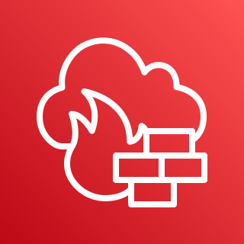












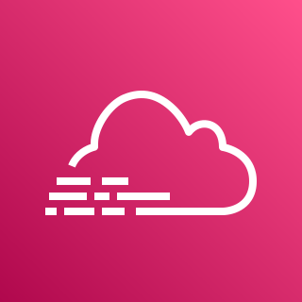


















AWS Cloud
인터넷 사용자
서울
VPC
Availability Zone
Public subnet
EC2 CentOS(WEB)
EC2 CentOS(WAS)
Security group
Auto Scaling group
Auto Scaling group
Private subnet
Private subnet
Security group
Security group
Availability Zone
Availability Zone
Private subnet
Private subnet
인터넷
10.0.0.0/24
10.1.0.0/24
c5a.xlarge 2개
t4g.medium 2개
master
standby
10.2.0.0/24
내부 사용자
VPN
DB backup
Security group
VPN
Security group
AWS Systems Manager
AWS CloudTrail
10.3.0.0/24
AWS Lambda
Security group
Security group
Private subnet
Amazon CloudWatch
Email
Amazon S3
Amazon S3
VPN
(Amazon SNS)
Mobile client
Azure cloud
호주
10.2.0.0/24
Azure Security
Center
Log Analysis
workspace
Azure Sentinel
Azure 리포트
(Optional)
Collector proxy(VPN)
File Storage
File Server

Slide 2

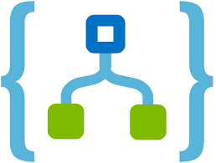
AWS Cloud
AWS Cloud
대전
서울
VPC
VPC
Availability Zone
Public subnet
Security group
Security group
Amazon S3
DB backup
Amazon S3
Log & event backup
EC2 Ubuntu(WEB)
EC2 Ubuntu(WAS)
Private subnet
인터넷
Auto Scaling group
Auto Scaling group
Private subnet
Private subnet
10.0.0.0/24
10.1.0.0/24
DB backup
standby
인터넷 사용자
Availability Zone
c5a.xlarge 2개
t4g.medium 2개
10.2.0.0/24
Security group
EC2 Ubuntu(WEB)
EC2 Ubuntu(WAS)
Private subnet
Auto Scaling group
Auto Scaling group
Private subnet
Private subnet
10.0.0.0/24
10.1.0.0/24
c5a.xlarge 2개
master
t4g.medium 2개
10.2.0.0/24
(AWS DMS)
Azure cloud
Security group
10.2.0.0/24
내부 사용자
Log&event
Azure Security
Center
Log Analysis
workspace
Azure
Sentinel
Playbooks
Azure
리포트
AWS Systems Manager
AWS CloudTrail
AWS Lambda
(Optional)
Collector proxy(VPN)
File Storage
File Server
Amazon CloudWatch
AWS WAF
VPN
Security group
VPN
Private subnet
10.3.0.0/24
(Amazon SNS)
Email
Mobile client

